Slide 1


Teens Reaching Adulthood: Needs and Support for Improved Transitional care In Ontario (TRANSITION)
Dr. Jan Willem Gorter
OCHSU/HAHSO Transition Stakeholder Alliance Meeting
June 2, 2017

Slide 2

Potential for conflict(s) of interest
CanChild Centre for Childhood Disability Research developed/licenses/distributes/ products that will be discussed in this presentation: TRANSITION-Q
OCHSU/HAHSO Transition Stakeholder Alliance Meeting
June 2, 2017

Slide 3
Background

Slide 4
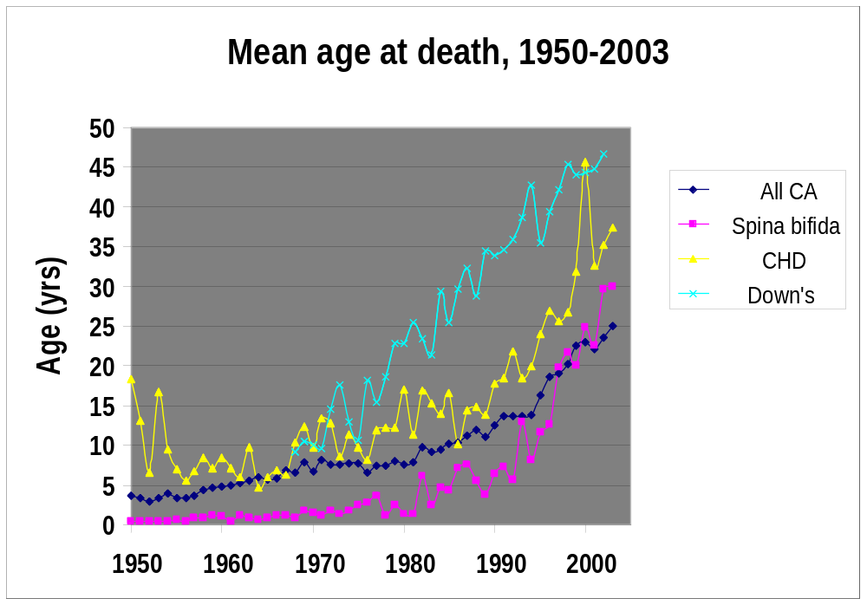
More Youth with Chronic Conditions Survive!
18 y
CA=Congenital Anomalies CHD= Congenital Heart Disease
Source: R. Wilkens, Health Canada, 2007

Slide 5
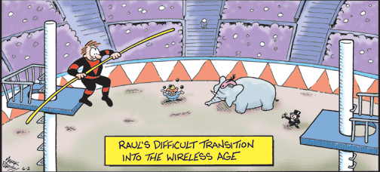
Transitions Can Be Challenging!

Slide 6
Health Transition & Transfer
Pediatric health care Adult health care
Transfer of care = point in time
Medical Transition: “the purposeful, planned movement of adolescents and young adults with chronic physical and medical conditions from child-centered to adult-oriented health care systems.”
Transfer: the movement to a new health care setting, provider, or both.
Blum 1993, Rosen, 2006
Notes:
Health transition
Broad and growing up – focus more in the context of healthcare – so many other transitions – school, social system, also important but focus on the transition in context of healthcare., role of children’s hospital and professionals

Slide 7
What Are the Issues?
The good:
  More youth with chronic conditions survive into adulthood!
  It is well recognized by multiple stakeholders that most adverse outcomes in experience of care, population health and costs are preventable
The bad:
  Healthcare transition from pediatric to adult services is not easy and comes with a ‘cost’
  Parents are reporting a greater need for support around the transition period
The ugly:
  Lack of systematic evaluation of the effectiveness of interventions to improve the transition process
  Gorter et al BMJ Open 2015

Slide 8
Unplanned Transition
When transition to adult care is unplanned or poorly supported, it could lead to:
  Poor health outcomes
  Costly hospitalizations
  Inequity of healthcare services
  Missed school or work
  Higher rates of health-risk behaviours
There is a general consensus that most of these unpleasant outcomes are preventable

Slide 9
Transition Field
Grown immensely to include models and interventions to improve transitions
Challenges surrounding current transition programs:
  Condition- or centre-specific
  Not evaluated or evidence-based
  Use of ‘home-grown’ measurement tools
  Focus on transfer and not transition process
  Disregard to population health

Slide 10
Obstacles to Successful Transition
Many youth are not “transition ready” at the system-driven “transfer” point, and remain ill-equipped to navigate the complex adult health care system
The lack of developmentally appropriate tools to assess child and family readiness for transition as a barrier to transition
Informed by the Community of Practice on Transition to Adulthood:
- Provincial Council for Maternal and Child Health (PCMCH)
- Canadian Association of Pediatric Health Centres (CAPHC)

Slide 11
Transition-Q
This instrument has been developed with and tested
  In a population of adolescents aged 12 to 18 years
  With a broad range of chronic health conditions, including neurodevelopmental conditions
Klassen et al, CCHD 2014

Slide 12
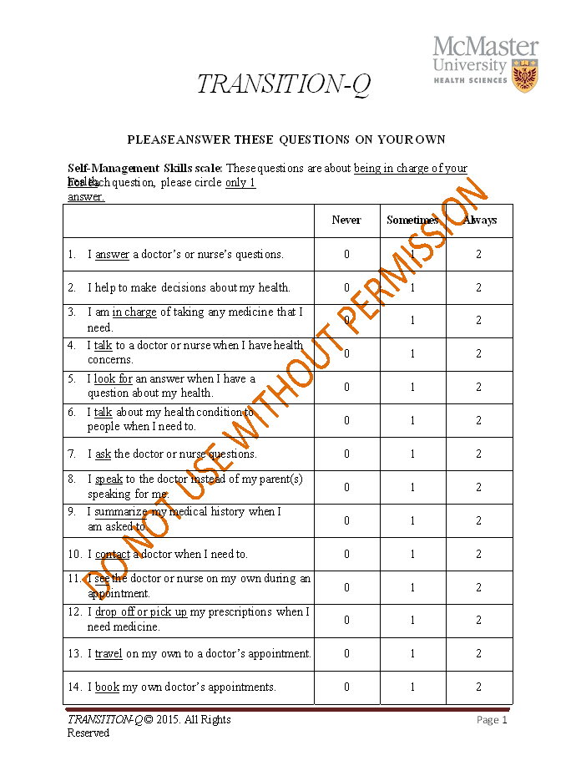
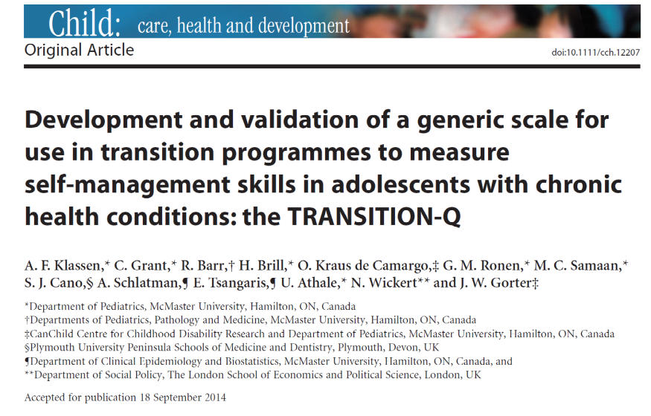





Slide 13
Conclusion
The TRANSITION-Q is a short, clinically meaningful and psychometrically sound scale that can be used in research and clinical practice to help to evaluate readiness for transition in adolescents aged 12 and older.

Slide 15

Teens Reaching Adulthood:
Needs and Support for Improved Transitional care In ONtario (TRANSITION)
Identify and understand transition gaps/issues from various stakeholder perspectives
Build a Provincial Transition Research Agenda
Implement and evaluate the Transition-Q in 7 Ontario sites

Slide 16

Year 1 (2014-2015)
On November 14, 2014, a meeting was held that brought together over 30 stakeholders.
There was unanimous agreement that a collaborative approach to improved transition was needed.

Slide 17
Environmental Scan (1)
Goal: A fundamental understanding of current transition programs across Ontario.
We determined 29 transition programs in Ontario, predominantly with a condition- or centre-specific focus.
Many of the programs are operated only within Children’s Hospitals with comparatively less adult provider involvement

Slide 18
Environmental Scan (2)
The majority of transition programs are not evaluated or evidence-based.
There is a consistent use of ‘home-grown’ measurement tools which may not be psychometrically sound or allow for comparison across sites.
Few programs assessed transition specifically for those who are medically complex, have developmental delays, or who are technology dependent

Slide 19
Year 2 (2015-2016) Implemention & Validation TRANSITION-Q (12-18+)
City | Site | Investigator(s)
Hamilton | McMaster Children’s Hospital | Jan Willem Gorter; Briano DiRezze; Christina Grant; Anne Klassen; Dayle McCauley; Vicky Breakey
Kingston | Kingston General Hospital | Karen Grewal
London | St. Joseph’s Healthcare | Kathy Speechley; Caitlin Cassidy
Ottawa | CHEO | Chantal Krantz
Toronto | Sick Kids | Khush Amaria
Toronto | Holland Bloorview Kids rehab | Shauna Kingsnorth
Toronto | North-York General Hospital | Sandra Doyle-Lisek; Marlene Taube-Schiff (Sunnybrook)
Other |  | Beverly Guttman – PCMCH, Toronto
Notes:
Double check the protocol

Slide 20
Research Question
Objectives:
  To measure “transition readiness” in adolescents and young adults between the ages of 12-25 with a range of different chronic or complex health conditions
  To further validate the TRANSITION-Q across 7 healthcare centres in Ontario
  To triangulate the “transition readiness” responses of the participant, the patent/caregiver, and the healthcare provider

Slide 21
Young Person
Parent / Caregiver
Healthcare Provider
Gorter et al., BMJ Open 2015

Slide 22
Design
Cross-Sectional Study across the 7 sites
Data collected at one time point

Slide 23
Population
A non-categorical approach recognizing that progress for improved transition has been halted by the limited focus on singular diagnostic groups
Youth aged 12 to 25 years recruited from participating clinics at the 6 Pediatric Academic Health Centres + North York General in Ontario.

Slide 24
Site | Clinics Involved | Target Number of Participants | Number of Participants
McMaster | Diabetes, Adolescent Medicine, Cardiology, Nephrology, Developmental, Neurology | 75 | 75
Holland Bloorview | Childhood Developmental Clinics (excluding Spina Bifida) | 50 | 16
London | Cardiology, CP, Spina Bifida, Developmental Delay | 50 | 49
Kingston | All pediatric clinics, Some adult (congenital heart disease, epilepsy) | 50 | 24
Sick Kids | Neurosurgery, General Surgery, Diabetes, Neurology | 75 | 66
CHEO | Nephrology, Hematology, Oncology | 50 | 50
North York General | Eating Disorders, Day Hospital |  | 33
TOTAL |  | 350 | 313

Slide 25
Measures
Demographic Common Data Elements
Participant Package: TRANSITION-Q (self-management skill scale) & SF-6D (health status measure)
Parent/Caregiver Questionnaire: describe the relation to the participant, the participants’ readiness to transfer, shared management, and transition support
Health Care Provider Questionnaire: rate patients readiness to transfer, the parent/caregiver’s ability to allow their child to transfer, if the participant is considered medically complex, their transition program status, and shared management

Slide 26
Results

Slide 27
Participant Demographics
Age | Number of Participants
12 | 15
13 | 23
14 | 27
15 | 37
16 | 52
17 | 91
18 | 34
19 | 6
20 | 3
21 | 5
22 | 3
23 | 2
24 | 3
25 | 1
Blank | 11
Gender | Number of participants
Male | 148
Female | 156
Other | 1
Prefer not to answer | 1
Blank | 7
Complex Condition | Number of Participants
Yes | 118
No | 173
No Response | 22

Slide 28
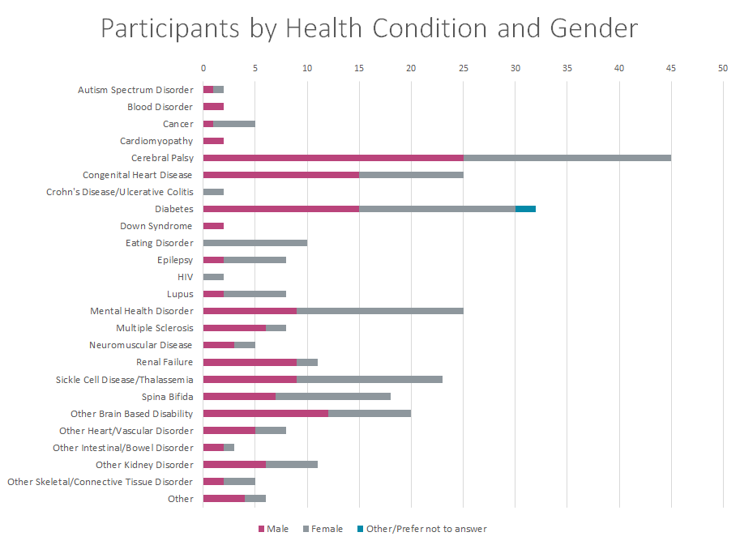

Slide 29
Mostly developmental disabilities

Slide 30
Transition-Q Score vs. I am Ready Statement

Slide 31
Shared Management Model by Age
(1=100% managed by parent, 10=100% managed by youth)

Slide 33
TRANSITION-Teens Reaching Adulthood: Needs and Support for Improved Transitional care In ONtario
Poll results

Slide 34
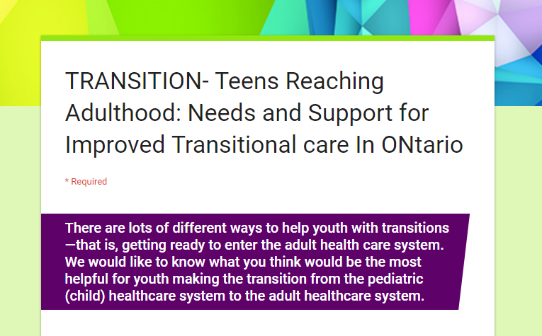
What We Did
Survey to ask what would be helpful for a person with a chronic health condition going through transition
Circulated primarily using social media

Slide 35
Results
49 stakeholders participated
  A Healthcare Provider (n=15)
  A Parent/Caregiver (n=17)
  Over 18 (already transferred to the adult healthcare system) (n=12)
  Under 18 (have not transferred to the adult healthcare system) (n=5)
APPs were a desired intervention by the majority of stakeholders
Other interventions such as practicing with paediatric healthcare teams, support groups, and educational materials, had differences in interest

Slide 36
Apps
71% of all survey responders thought that tools that can help with organizing/managing healthcare, such as an APP would be beneficial

Slide 37
Apps
Apps that has tips about communication is less favourable, especially in youth over 18
Overall the majority of respondents would find an APP beneficial for transition

Slide 38
In-Clinic Interventions
Disparity between what HCP and youth/young adults would find helpful especially in terms on in-clinic supports like discussions with healthcare team and practicing
Could be a number of reasons for the differences

Slide 39
Education & Support
Less support for support groups/peer interaction- particularly from parents
Educational materials were seen as helpful from the HCP/parent perspective but youth in large part did not think these interventions would be helpful

Slide 40
A Couple of Quotes
“My specialists were helpful in making connections during transition - arranging for meetings with both my pediatric and adult specialists helped ensure that my unique needs were effectively communicated when transferring.” –Youth (>18 years old)
“I think there could have been more things that would have been helpful, such as tools for navigating the system on my own without parents, or getting connected with similar aged and people with similar conditions as myself” –Youth (>18 years old)
“As a parent, I was the only one guiding my son to take responsibility for himself until the TLC clinic started.” -Parent

Slide 41
Further Psychometric Validation of the Transition-Q
Anne Klassen, DPhil
OCHSU/HAHSO Transition Stakeholder Alliance Meeting
June 2, 2017

Slide 42






WOUND-Q

Slide 43
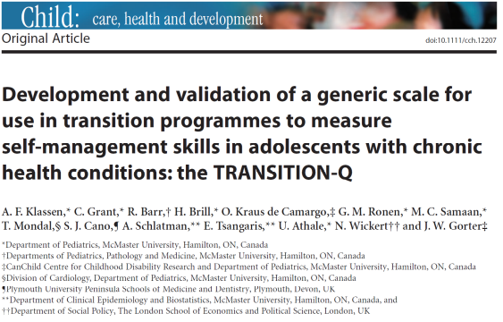
Methods
PRO instrument 3 step development approach:
Phase I:
Item Generation
Phase II:
Item Reduction
Phase III:
Psychometric Evaluation
What should we measure?
Which questions are effective?
Does the instrument work?
validation sample
original sample

Slide 44

How does Transition-Q work?

Slide 45
Hierarchy
Do the items in a scale map out the hypothesized construct?
less
more

Slide 46

A Continuum of Difficulty
rolling over
walking
MOBILITY

Slide 47
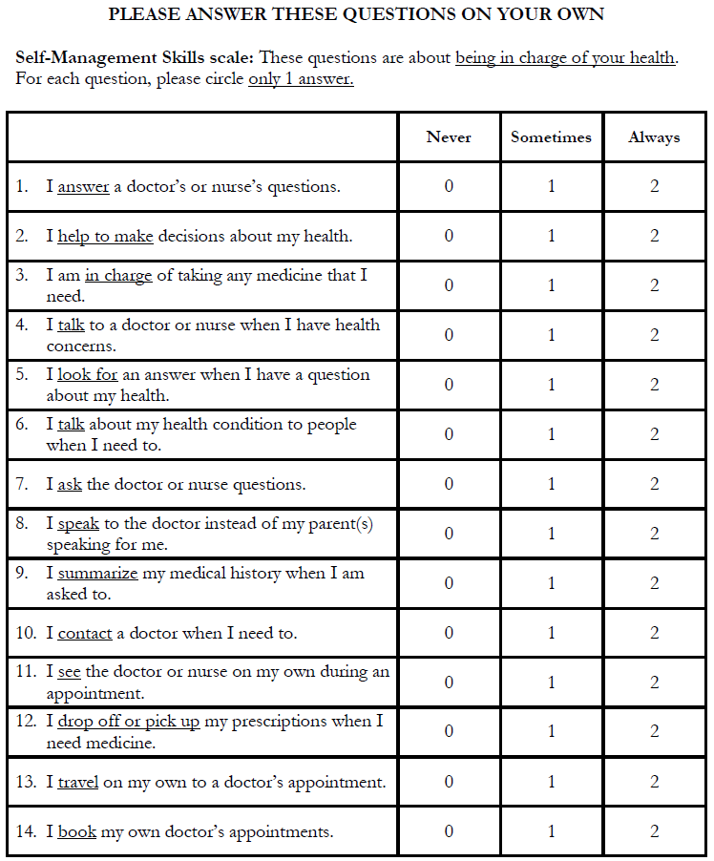




Slide 48
Data Analysis
Rasch Measurement Theory:
Thresholds for item response options
Item fit statistics
Item locations
Differential item function
Person separation index
Classical Test Theory:
Internal consistency reliability (Cronbach’s alpha)
Test-retest reliability
Known-groups validity
Notes:
Just say something like the analysis involves a range of tests to ensure the scale is clinically meaningful and scientifically sound. These include both modern psychometric methods (Rasch measurement theory analysis) and classical test theory analysis. I will not have time to go into detail about these tests, but will highlight a few of the preliminary findings.

Slide 49
Samples & Recruitment
Original Sample
Validation Sample
Recruitment May 13 – Aug 13
1 Site – MCH
Any medical condition
Aged 12-18 years
Had not transitioned to adult care
Recruitment Oct 15 – Apr 17
7 sites
Chronic or complex condition
Aged 12-25 years
May have transitioned to adult care

Slide 50
Validation Sample by Site
Site | N
McMaster | 75
SickKids | 66
CHEO | 50
London | 49
Holland Bloorview | 16
Kingston | 24
NYGH | 33
Total | 313

Slide 51
Original Sample: 337 Participants by Health Condition & Gender
Notes:
The comment here can be to show the discrepancy of gender for Eating Disorder and Mental Health. The other groups are balanced

Slide 53
Number of Participants by Gender
Notes:
The boys are significantly younger than girls (p=.012 on t-test). Also, there are 134 boys (40%) and 202 girls (60%). This difference is due to more girls with eating disorders and mental health issues that will be shown on condition slide.

Slide 54
Number of Participants by Age

Slide 55
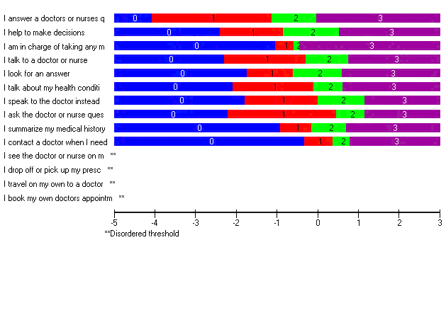
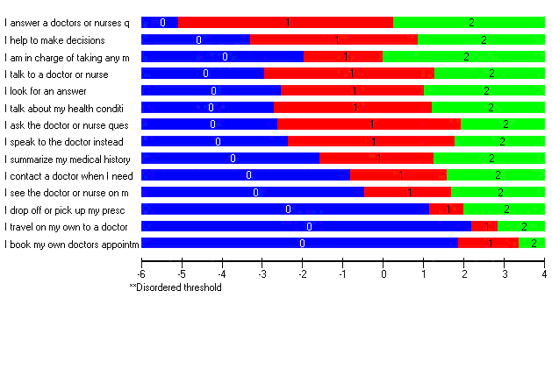
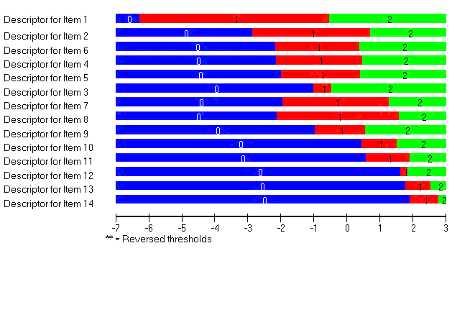
Response Options
Never | Sometimes | Often | Always
Original Sample
Validation Sample

Slide 56
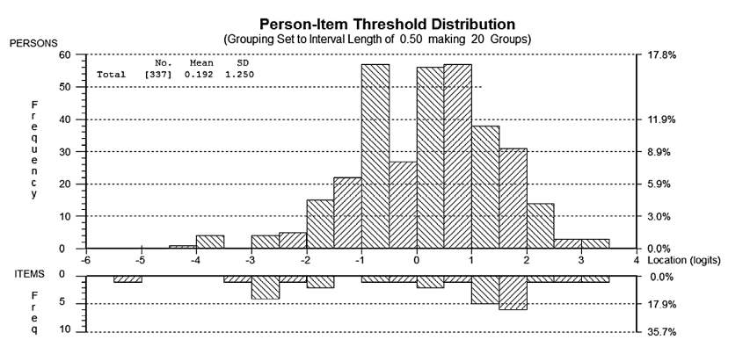
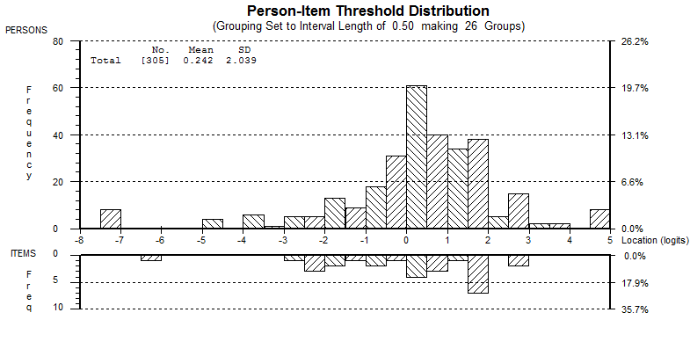
Targeting
Original sample
Validation sample
Easier
Harder
Easier
Harder

Slide 57
Reliability
 | Person Separation Index | Cronbach Alpha
Original | 0.847 | 0.851
Validation | 0.89 | 0.90
Minimum standard ≥ 0.80

Slide 58
Fit to the Rasch Model
Study
Original
Validation
Chi-square | Degrees of freedom | p-value
0.94 | 56 | 0.13
0.86 | 56 | 0.01
Observed data (patients’ responses) compared with expectations of Rasch model
Notes:
You want this Chi-square to not be significant as it means that the data fit the model. Thus, the estimates derived from the model are considered appropriate because the measurement theory (our hypothesized construct – clinical hierachy of items) is supported by the data. It is thus legitimate to sum the 14 items together to get a total score.

Slide 59
Construct Validity
Hypothesis 1:
Older participants will report higher Transition-Q scores than younger participants.

Slide 60
Mean Score by Age (p-values <0.01)

Slide 61
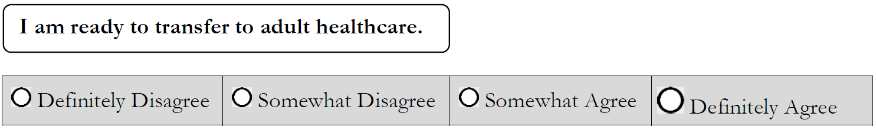
Construct Validity
Hypothesis 2:
Transition-Q scores will be incrementally higher by strength of agreement with:

Slide 62
Question: I am ready to transfer to adult healthcare (p-values <0.01)

Slide 63
Clinical Application
How can Transition-Q be used in clinical practice?

Slide 64
17 year old male with ABI (no concussion); scored 45/100
Easy
Hard
Notes:
Here is an example of how the scale could be used in clinical practice. Here are 2 patients, both aged 15 and female with Crohns. The first patient scored very low on the SMS scale with a score of 26 putting her in the bottom 5 %. You can see that she mostly never or sometimes do the range of skills asked about in this scale. The second patient is same age, gender and condition but you can see that she almost always exhibits the skills except for the 2 at the end of the scale. So the pattern of results can be used to show the strengths and limitations for a patient and where one can target the education and resources.

Slide 65
Interpretation Table
 | Never | Sometimes | Always
I answer a doctor’s or nurse’s questions. | 0-0 | 0-53 | 53-100
I help to make decisions about my health. | 0-17 | 17-59 | 59-100
I am in charge of taking any medicine that I need. | 0-30 | 30-50 | 50-100
I talk to a doctor or nurse when I have health concerns. | 0-20 | 20-63 | 63-100
I look for an answer when I have a question about my health. | 0-24 | 24-60 | 60-100
I talk about my health condition to people when I need to. | 0-23 | 23-62 | 62-100
I ask the doctor or nurse questions. | 0-24 | 24-70 | 70-100
I speak to the doctor instead of my parent(s) speaking for me. | 0-26 | 26-68 | 68-100
I summarize my medical history when I am asked to. | 0-34 | 34-63 | 63-100
I contact a doctor when I need to. | 0-42 | 42-66 | 66-100
I see the doctor or nurse on my own during an appointment. | 0-45 | 45-67 | 67-100
I drop off or pick up my prescriptions when I need medicine. | 0-62 | 62-70 | 70-100
I travel on my own to a doctor’s appointment. | 0-72 | 72-79 | 79-100
I book my own doctor’s appointments. | 0-69 | 69-84 | 84-100
12 year olds (N 22), Mean =38, SD 24 Range 0 to 100
3 scores above 84
17 year olds (N 90), Mean =58, SD 24
Range 0 to 100
9 scored above 84

Slide 66
Conclusion
TRANSITION-Q is a reliable and valid 14-item measure of self-management skills
TRANSITION-Q can be used in clinical practice to measure self-management skills
TRANSITION-Q can be used in research
  How do scores change over time and with interventions?

Slide 67
Thank-Q

Slide 68
Summary

Slide 69
Obstacles to Successful Transition Addressed by OCHSU
Many youth are not “transition ready” at the system-driven “transfer” point, and remain ill-equipped to navigate the complex adult health care system
The lack of developmentally appropriate tools to assess child and family readiness for transition as a barrier to transition

Slide 70
Remaining Obstacles to Address
  Lack of communication/information between the pediatric and adult healthcare systems ✓
  Poor availability of programs/resources ✓
  Lack of an identified staff person responsible for transition ✓
  Anxiety on the part of pediatricians, adolescents, and their parents about planning for their future health care ✓
  Limited staff training
Provincial Council for Maternal and Child Health (PCMCH), 2013; AAP, 2011
Notes:
Open floor to discuss transition experiences

Slide 71
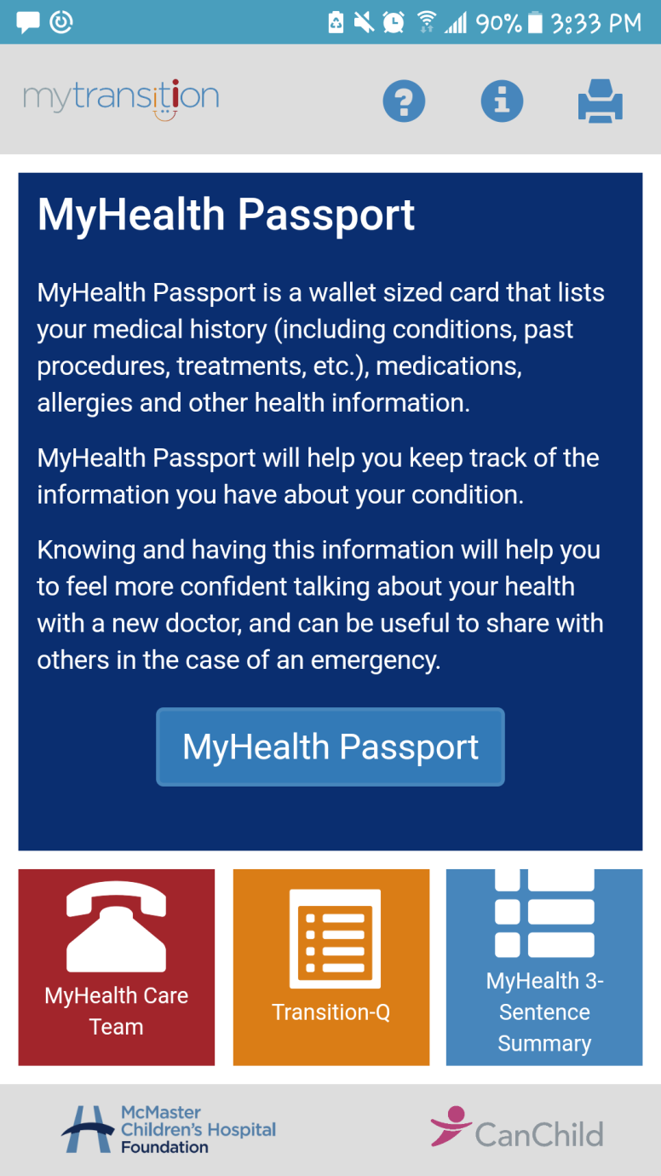
Solution to Obstacles → MyTransition App

