Slide 1



An app-based Transition Toolkit targeting youth with chronic health conditions: A randomized control trial as a foundation to improve healthcare transitions and outcomes
The ApplyIT Study
Apply the MyTransition App In Transition
Dr. Jan Willem Gorter & Nadilein Mahlberg, MSc
OCHSU/HAHSO Transition Stakeholder Alliance Meeting
June 2, 2017

Slide 2
The ApplyIT Study Team
Multidisciplinary group from McMaster University and Hamilton Health Sciences, and an extension of previous successful collaborations in transition research.
Co-PIs: Drs. Jan Willem Gorter & Christina Grant
Co-Applicants: Drs. Lehana Thabane (Statistics), Steve Arora (Nephrology), Tapas Mondal (Cardiology), Andrew Don Wauchope (Lipids), Zubin Punthakee (Diabetes), Gabriel Ronen (Neurology) and Vicky Breakey (HaemOnc)
MCH Quality Improvement Leads: Lisa Skradski & Tracy Akitt
Collaborator: Khush Amaria
Youth Collaborators: Julia Hanes & Nini Nguyen

Slide 3
The ApplyIT Study
Pilot RCT

Slide 4
Research Purpose
Responds to the need for a systematically well-designed research approach to developing evidence-based transition tools
Tools that can be:
  Affordable
  Easily implemented in healthcare systems
  Applicable to the majority of youth with chronic health conditions

Slide 5
Research Question
Objectives:
  To collect information to design a large multi-centre RCT to assess implementation of the MyTransition app
  To assess the feasibility and potential effect of the MyTransition app-based transition toolkit for improving health of youth, healthcare transition experience, and achievement of health and life goals

Slide 6
Design
Pilot RCT informed by patient and family stakeholders
“I believe that every single 17 year old has the right to have a successful transition to adult care because it is such a vulnerable and essential period in their life. I truly believe that the project will be a key player in evaluating the effectiveness of a successful transition and ultimately leading to better health outcomes. This project will help to spread awareness of the importance of transitions to health care professionals so it is made a priority when youth enter that stage in their life”.
(From Letter of Support by Nini Nguyen, Youth Collaborator)

Slide 7
Outcomes
Primary Outcome:
  Feasibility
    Completion rate of 90%
    Engagement of patients, parents, and HCPs
    Integration of the intervention in healthcare systems

Slide 8
Outcomes
Secondary Outcomes
  Assess potential effect of an app-based transition toolkit for improving:
    Health of youth (Quality of Life)
      Short-Form Six-Dimension (SF-6D)
    Healthcare transition experience
      Client satisfaction questionnaire, qualitative interviews
    Achievement of health and life goals
      Canadian Occupational Performance Measure (COPM)

Slide 9
Sample
100 youth (50 in each arm) between the ages of 14-18 with a chronic health condition, who attend a participating clinic at MCH
Must be able to utilize the intervention tool as well as read and understand English
Must be independent in areas of daily functioning, self-care and/or communication

Slide 10
Sampling
Convenience sampling
Draw sample from 8 different clinics with MCH:
Nephrology Cardiology Lipids Diabetes | Neurology HaemOnc Developmental Pediatrics Adolescent Medicine

Slide 11
Methods
Participants will be screened by affiliated clinic and potential participants will be approached by RC
Participants will sign consent and complete baseline visit
Randomized into intervention or control group
Complete 3- and 6-month follow-up visits

Slide 12
Intervention
Provided link to download the MyTransition app
RC will review with participants and parents how to use the app in interactions during and outside of clinic visits for condition management
Receive monthly reminder messages from RC to promote the use of the app in interactions with HCPs at all clinic visits
Review of transition goals set by the participant with participant and parent

Slide 13
Measures
Demographic Common Data Elements: detailed demographic information and eHealth literacy
TRANSITION-Q: transition readiness/self-management ability scale
Short-Form Six Dimension: describes and values individuals’ health
Client Satisfaction Questionnaire: measures satisfaction with health and human services received by individuals and families
Canadian Occupational Performance Measure: captures a client’s self-perception of performance and satisfaction in everyday living, over time

Slide 14
Qualitative Interviews
Will qualitatively explore experiences and perceptions of youth, parents, and HCPs about transition to adult healthcare
Purposefully sample 10 youth from the intervention group, along with 10 each of their parents and HCPs
  Triangulation of sources
  Individual interviews

Slide 15
Timeline
Year 1
  Create and finalize all study documents
  Obtain ethics approval
  Complete participant recruitment and begin follow-up visits
  Conduct qualitative interviews
  Start qualitative analysis

Slide 16
Timeline
Year 2
  Complete participant follow-up (3- and 6-month visits)
  Complete qualitative analysis
  Customize app based on feedback
  Hold stakeholder alliance meeting
  Start and complete quantitative analysis
  Manuscript preparation and submission
  Finalize plan for multi-centre RCT

Slide 17
Expansion of the ApplyIT Study
Multi-Centre RCT

Slide 18
Multi-Centre RCT
Expand to hospitals and organizations within Ontario
  TRANSITION Research network (7 sites)
Possible funding agencies
  PSI
  CIHR

Slide 19
Group Discussion
How would you see this study being rolled out within your clinic/organization?
What are some points we need to consider moving forward?
Additional comments/questions??

Slide 21

MOVING FORWARD…
with a focus on Intervention Studies
Dr. Jan Willem Gorter
OCHSU/HAHSO Transition Stakeholder Alliance Meeting
June 2, 2017

Slide 22
Program of Transition Research
Foundation
Grant
App??
De
Jan
16
Jan
17
Jan
18
Jan
19
Jan
20
Jan
21
Jan
22
c
22
Chronic Health Conditions
Transition
Q
‐
OCHSU
2014
2017
2017
HAHSO
‐
2019
2018
PSI
‐
2020
Brain Based Disorders
2016
CHILD
‐
2021
‐
BRIGHT
2014
Kids
Brain
Health
‐
2019
Potential
to
renew
for
5
more
year
s
2013
OBI
‐
2018
Potential
to
renew
for
5
more
years

Slide 23
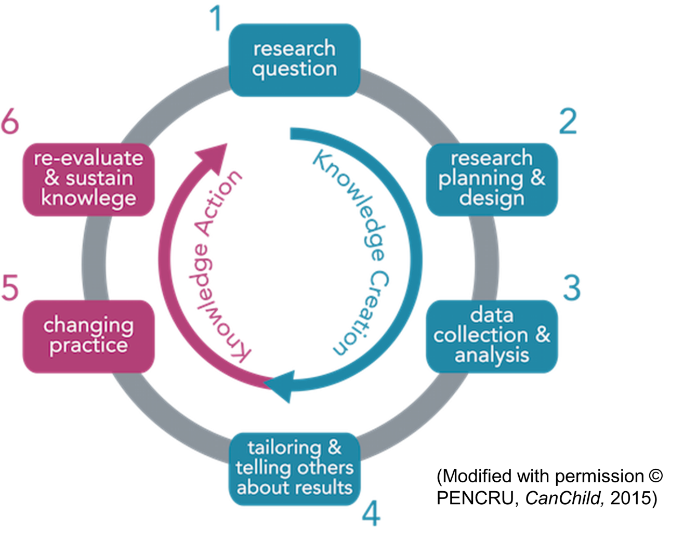
Transition Research Network with Stakeholder Involvement

Slide 24
Roles for Youth and Families
Family Researchers: Parents/youth that are interested in partnering on individual research teams
Family Collaborators: Review & provide feedback on research proposals, grant applications, KT products, etc.
Family Communicators: Participate in PPR/Youth Facebook Groups, be a knowledge broker in the community - inform people about Transition research & activities (e.g., webinars, workshops)

Slide 25
Establishing Stakeholder Alliance
Who?
What?
When?
Where?
Why?

Slide 26
Thank-Q!

